Slide 1
Encoding Operators and Operands
P&H Chapter 2.1 to 2.6

Slide 2
Outline
Arithmatic Operations and Operands
Register operands
Memory operands
Immediate operands
Representing integers
Binary integers
Signed integers (2s complement)
Signed negation
Signed extensions
Representing instructions
Logical operations

Slide 3
Instruction Set
The repertoire of instructions of a computer
Different computers have different instruction sets
But with many aspects in common
Early computers had very simple instruction sets
Simplified implementation
Many modern computers also have simple instruction sets

Slide 4
The MIPS Instruction Set
Used as the example throughout the book
Stanford MIPS commercialized by MIPS Technologies (www.mips.com)
Large share of embedded core market
Applications in consumer electronics, network/storage equipment, cameras, printers, …
Typical of many modern ISAs
See MIPS Reference Data tear-out card, and Appendixes B and E

Slide 5
Arithmetic Operations
Add and subtract, three operands
Two sources and one destination
add a, b, c # a gets b + c
All arithmetic operations have this form
Design Principle 1: Simplicity favours regularity
Regularity makes implementation simpler
Simplicity enables higher performance at lower cost

Slide 6
Arithmetic Example
C code:
f = (g + h) - (i + j);
Compiled MIPS code:
add t0, g, h # temp t0 = g + h add t1, i, j # temp t1 = i + j sub f, t0, t1 # f = t0 - t1

Slide 7
Register Operands
Arithmetic instructions use register operands
MIPS has a 32 × 32-bit register file
Use for frequently accessed data
Numbered 0 to 31
32-bit data called a “word”
Assembler names
$t0, $t1, …, $t9 for temporary values
$s0, $s1, …, $s7 for saved variables
Design Principle 2: Smaller is faster
c.f. main memory: millions of locations

Slide 8
Register Operand Example
C code:
f = (g + h) - (i + j);
f, …, j in $s0, …, $s4
Compiled MIPS code:
add $t0, $s1, $s2 add $t1, $s3, $s4 sub $s0, $t0, $t1

Slide 9
Memory Operands
Main memory used for composite data
Arrays, structures, dynamic data
To apply arithmetic operations
Load values from memory into registers
Store result from register to memory
Memory is byte addressed
Each address identifies an 8-bit byte
Words are aligned in memory
Address must be a multiple of 4
MIPS is Big Endian
Most-significant byte at least address of a word
c.f. Little Endian: least-significant byte at least address

Slide 10
Memory Operand Example 1
C code:
g = h + A[8];
g in $s1, h in $s2, base address of A in $s3
Compiled MIPS code:
Index 8 requires offset of 32
4 bytes per word
lw $t0, 32($s3) # load word add $s1, $s2, $t0
offset
base register

Slide 11
Memory Operand Example 2
C code:
A[12] = h + A[8];
h in $s2, base address of A in $s3
Compiled MIPS code:
Index 8 requires offset of 32
lw $t0, 32($s3) # load word add $t0, $s2, $t0 sw $t0, 48($s3) # store word

Slide 12
Registers vs. Memory
Registers are faster to access than memory
Operating on memory data requires loads and stores
More instructions to be executed
Compiler must use registers for variables as much as possible
Only spill to memory for less frequently used variables
Register optimization is important!

Slide 13
Immediate Operands
Constant data specified in an instruction
addi $s3, $s3, 4
No subtract immediate instruction
Just use a negative constant
addi $s2, $s1, -1
Design Principle 3: Make the common case fast
Small constants are common
Immediate operand avoids a load instruction

Slide 14
The Constant Zero
MIPS register 0 ($zero) is the constant 0
Cannot be overwritten
Useful for common operations
E.g., move between registers
add $t2, $s1, $zero

Slide 15
Unsigned Binary Integers
Given an n-bit number
Range: 0 to +2^{n} – 1
Example
0000 0000 0000 0000 0000 0000 0000 1011₂ = 0 + … + 1×2³ + 0×2² +1×2¹ +1×2⁰ = 0 + … + 8 + 0 + 2 + 1 = 11₁₀
Using 32 bits
0 to +4,294,967,295

Slide 16
2s-Complement Signed Integers
Given an n-bit number
Range: –2^{n – 1} to +2^{n – 1} – 1
Example
1111 1111 1111 1111 1111 1111 1111 1100₂ = –1×2³¹ + 1×2³⁰ + … + 1×2² +0×2¹ +0×2⁰ = –2,147,483,648 + 2,147,483,644 = –4₁₀
Using 32 bits
–2,147,483,648 to +2,147,483,647

Slide 17
2s-Complement Signed Integers
Bit 31 is sign bit
1 for negative numbers
0 for non-negative numbers
–(–2^{n – 1}) can’t be represented
Non-negative numbers have the same unsigned and 2s-complement representation
Some specific numbers
0: 0000 0000 … 0000
–1: 1111 1111 … 1111
Most-negative: 1000 0000 … 0000
Most-positive: 0111 1111 … 1111

Slide 18
Signed Negation
Complement and add 1
Complement means 1 → 0, 0 → 1
Example: negate +2
+2 = 0000 0000 … 0010₂
–2 = 1111 1111 … 1101₂ + 1 = 1111 1111 … 1110₂

Slide 19
Sign Extension
Representing a number using more bits
Preserve the numeric value
In MIPS instruction set
addi: extend immediate value
lb, lh: extend loaded byte/halfword
beq, bne: extend the displacement
Replicate the sign bit to the left
c.f. unsigned values: extend with 0s
Examples: 8-bit to 16-bit
+2: 0000 0010 => 0000 0000 0000 0010
–2: 1111 1110 => 1111 1111 1111 1110

Slide 20
Representing Instructions
Instructions are encoded in binary
Called machine code
MIPS instructions
Encoded as 32-bit instruction words
Small number of formats encoding operation code (opcode), register numbers, …
Regularity!
Register numbers
$t0 – $t7 are reg’s 8 – 15
$t8 – $t9 are reg’s 24 – 25
$s0 – $s7 are reg’s 16 – 23

Slide 21
MIPS R-format Instructions
op
rs
rt
rd
shamt
funct
6 bits
5 bits
5 bits
5 bits
5 bits
6 bits
Instruction fields
op: operation code (opcode)
rs: first source register number
rt: second source register number
rd: destination register number
shamt: shift amount (00000 for now)
funct: function code (extends opcode)

Slide 22
R-format Example
op
rs
rt
rd
shamt
funct
6 bits
5 bits
5 bits
5 bits
5 bits
6 bits
add $t0, $s1, $s2
special
$s1
$s2
$t0
0
add
0
17
18
8
0
32
000000
10001
10010
01000
00000
100000
00000010001100100100000000100000₂ = 02324020₁₆

Slide 23
Hexadecimal
Base 16
Compact representation of bit strings
4 bits per hex digit
0 | 0000 | 4 | 0100 | 8 | 1000 | c | 1100
1 | 0001 | 5 | 0101 | 9 | 1001 | d | 1101
2 | 0010 | 6 | 0110 | a | 1010 | e | 1110
3 | 0011 | 7 | 0111 | b | 1011 | f | 1111
Example: eca8 6420
1110 1100 1010 1000 0110 0100 0010 0000

Slide 24
MIPS I-format Instructions
op
rs
rt
constant or address
6 bits
5 bits
5 bits
16 bits
Immediate arithmetic and load/store instructions
rt: destination or source register number
Constant: –2¹⁵ to +2¹⁵ – 1
Address: offset added to base address in rs
Design Principle 4: Good design demands good compromises
Different formats complicate decoding, but allow 32-bit instructions uniformly
Keep formats as similar as possible

Slide 25
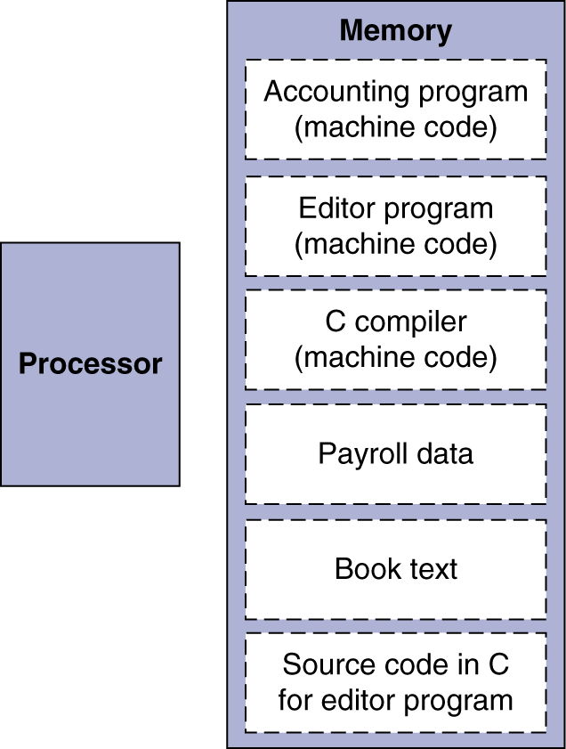
Stored Program Computers
Instructions represented in binary, just like data
Instructions and data stored in memory
Programs can operate on programs
e.g., compilers, linkers, …
Binary compatibility allows compiled programs to work on different computers
Standardized ISAs

Slide 26
Logical Operations
Instructions for bitwise manipulation
Operation | C | Java | MIPS
Shift left | << | << | sll
Shift right | >> | >>> | srl
Bitwise AND | & | & | and, andi
Bitwise OR | | | | | or, ori
Bitwise NOT | ~ | ~ | nor
Useful for extracting and inserting groups of bits in a word

Slide 27
Shift Operations
op
rs
rt
rd
shamt
funct
6 bits
5 bits
5 bits
5 bits
5 bits
6 bits
shamt: how many positions to shift
Shift left logical
Shift left and fill with 0 bits
sll by i bits multiplies by 2^{i}
Shift right logical
Shift right and fill with 0 bits
srl by i bits divides by 2^{i} (unsigned only)

Slide 28
AND Operations
Useful to mask bits in a word
Select some bits, clear others to 0
and $t0, $t1, $t2
$t2
0000 0000 0000 0000 0000 1101 1100 0000
$t1
0000 0000 0000 0000 0011 1100 0000 0000
$t0
0000 0000 0000 0000 0000 1100 0000 0000

Slide 29
OR Operations
Useful to include bits in a word
Set some bits to 1, leave others unchanged
or $t0, $t1, $t2
$t2
0000 0000 0000 0000 0000 1101 1100 0000
$t1
0000 0000 0000 0000 0011 1100 0000 0000
$t0
0000 0000 0000 0000 0011 1101 1100 0000

Slide 30
NOT Operations
Useful to invert bits in a word
Change 0 to 1, and 1 to 0
MIPS has NOR 3-operand instruction
a NOR b == NOT ( a OR b )
nor $t0, $t1, $zero
Register 0: always read as zero
$t1
0000 0000 0000 0000 0011 1100 0000 0000
$t0
1111 1111 1111 1111 1100 0011 1111 1111

